Slide 1
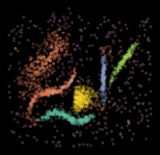
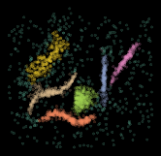
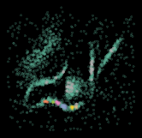
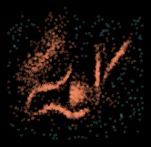



D
$$Λ(S)$$
strategy 1: ANMI maximization
produce ensemble
data
S
produce consensus clustering
strategy 2:
best match with
consensus clustering C*
$$C^{∗}$$
hyperparameter
configurations

Slide 2
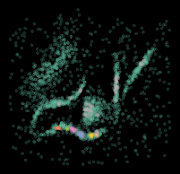




Slide 4
